Slide 1
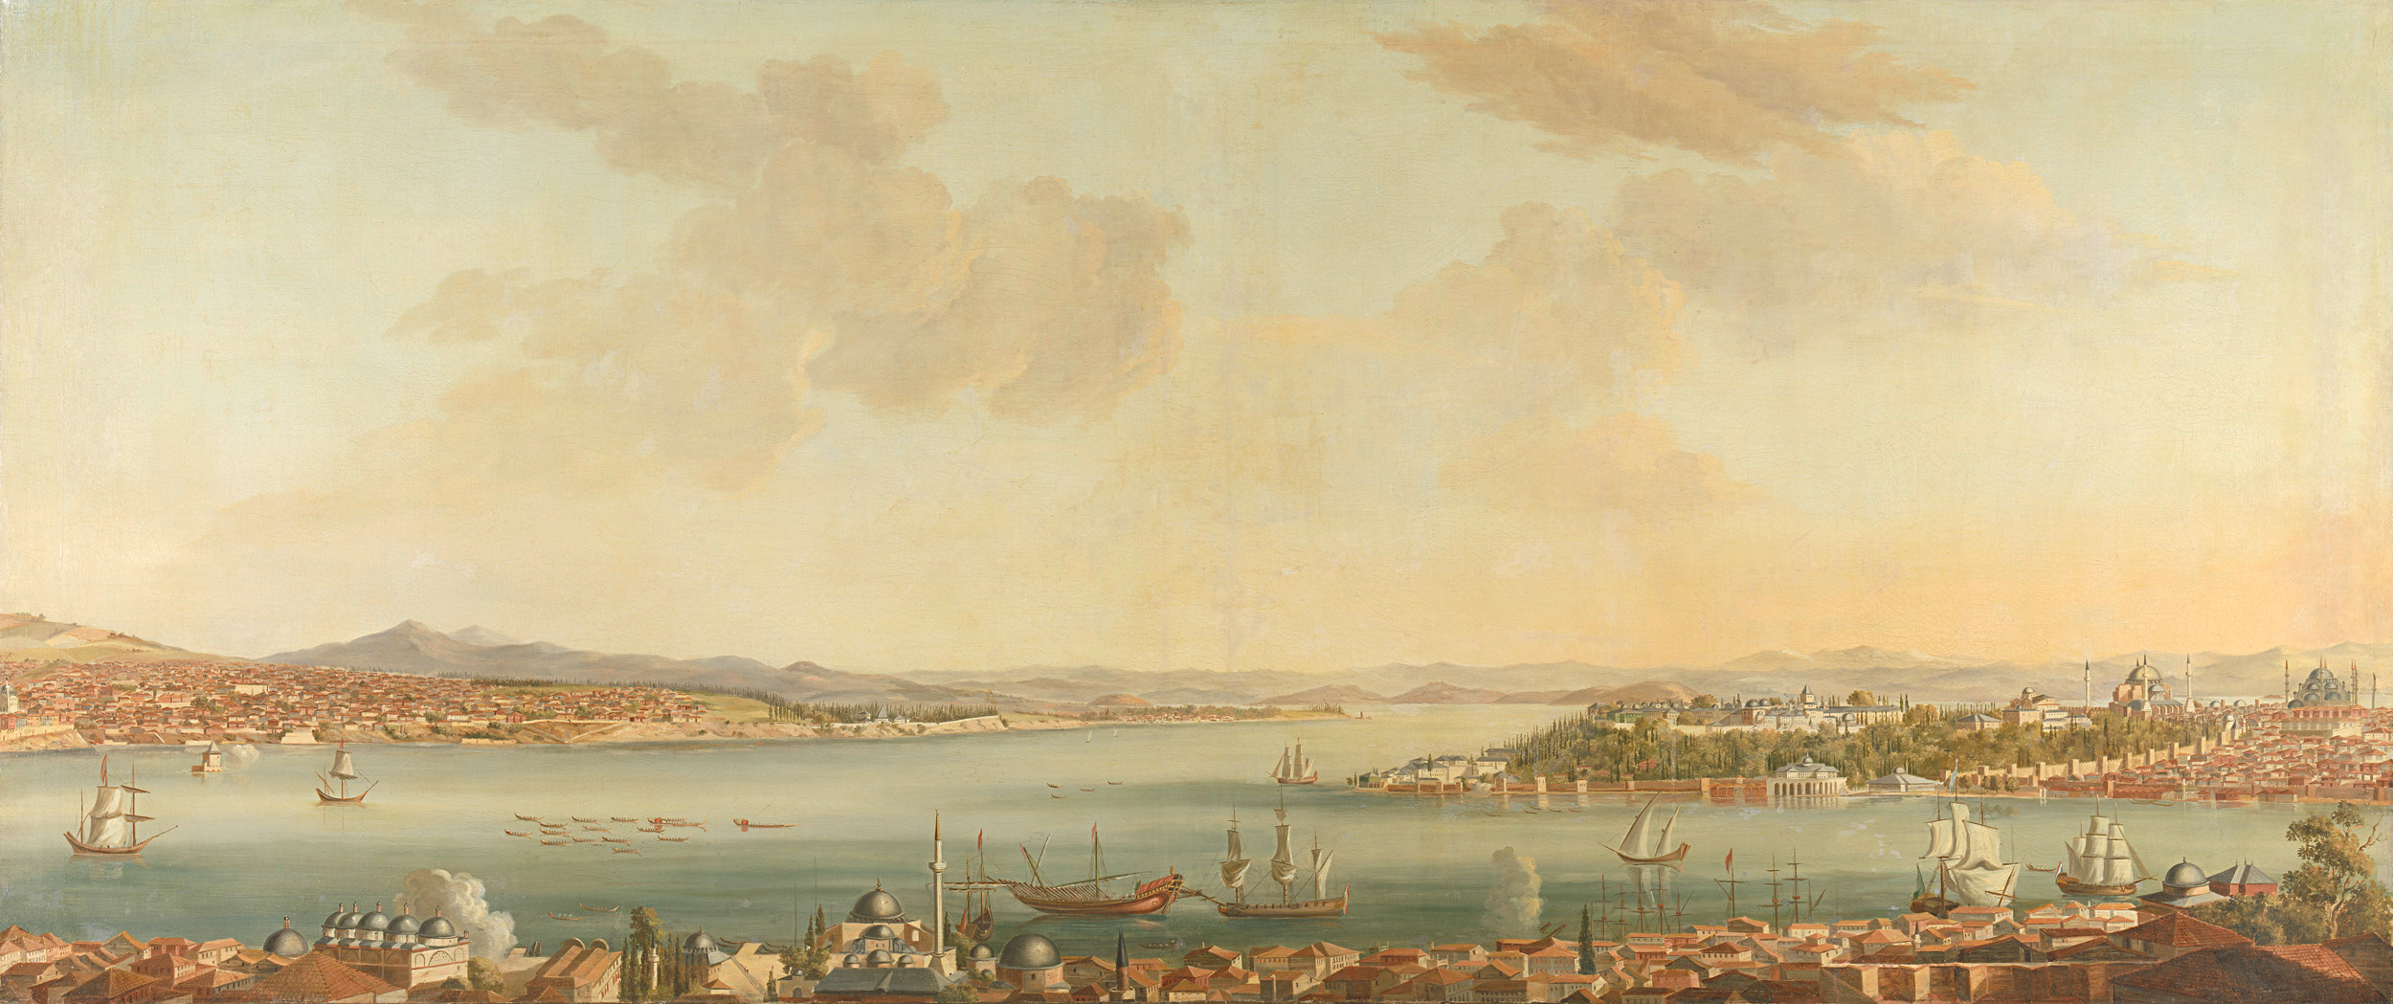

THE
ESP-32-Cam expirience
by Josue and Danail

Slide 2







INITIAL RESEARCH
IN A MOMENT OF DEPAIR
PROLOGUE
World
Map
THE GREAT DEPRESSION
A DEVISED
PLAN FOR SUCCESS
A GREAT SUCESS

Slide 3



Once upon a time...
There lived a Professor distributing cursed artifacts to unsuspecting Students
He promised them great fortunes and power if they were able to lift the curse
One such object was the “ESP-32-EYE”
2 brave students took it upon themselves to lifting the curse of...
getting it to at least display an image

Slide 4
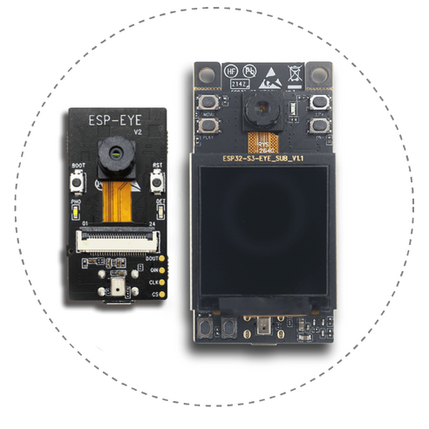

Initial Research
The students were LIED TO - it was the curse per chance
They did not recieve the right artifact
ESP-32S3-Eye -> ESP-32-Cam
But this still wasn’t the right artifact...

Slide 5



Slide 6
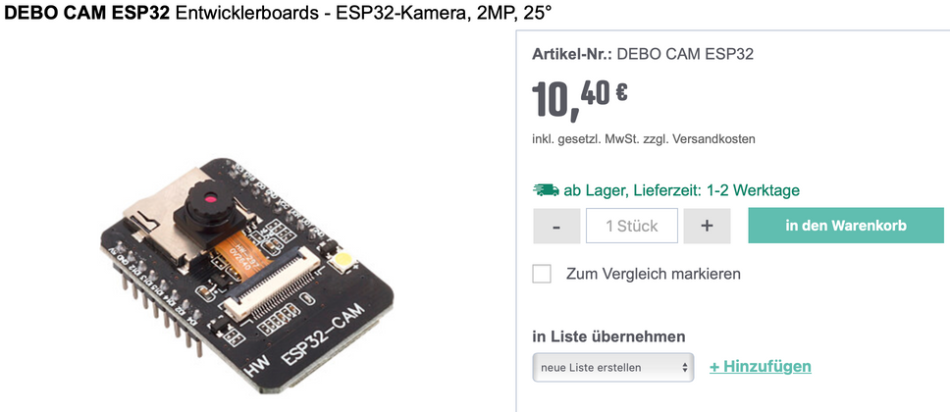

Initial Research
What the students thought they had...
What they actually had...

Slide 7
a devised plan for success
Even though the students didn’t have any specifications for the device - Curse of the Unknown
They still devised a plan which was simple to exectute:
Get a picture from the camera with web requests
write light local python code so it runs on all devices
use yolo-lite for object detection (maybe even object recognition)
run it :)
This way the students didn’t care about the device specifications!
They only needed to get the video sent trough the wi-fi -> A monumental task

Slide 8
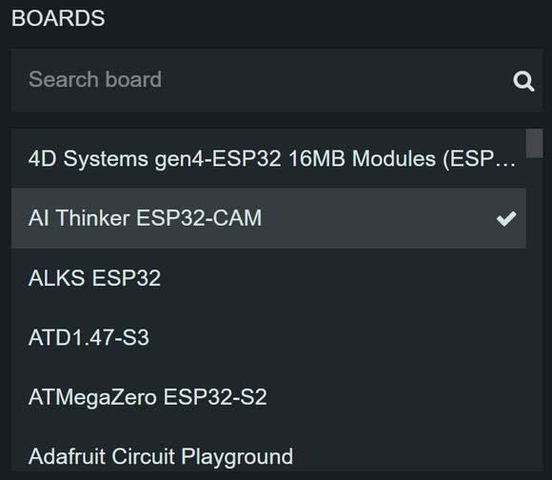
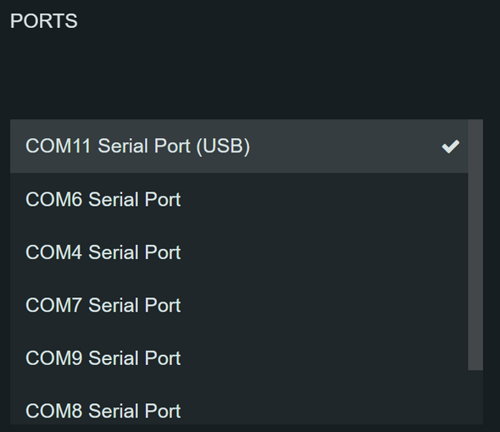
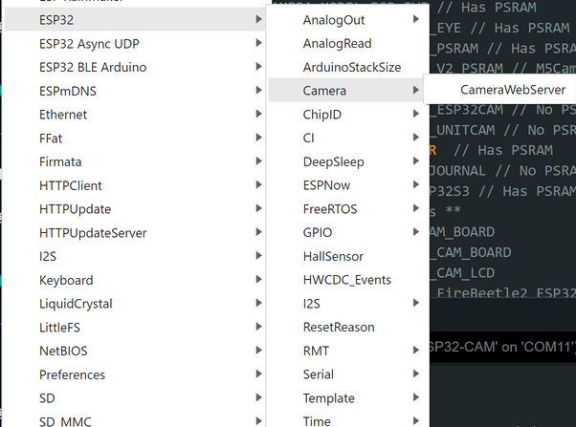
Get a picture from the camera with web requests

Slide 9
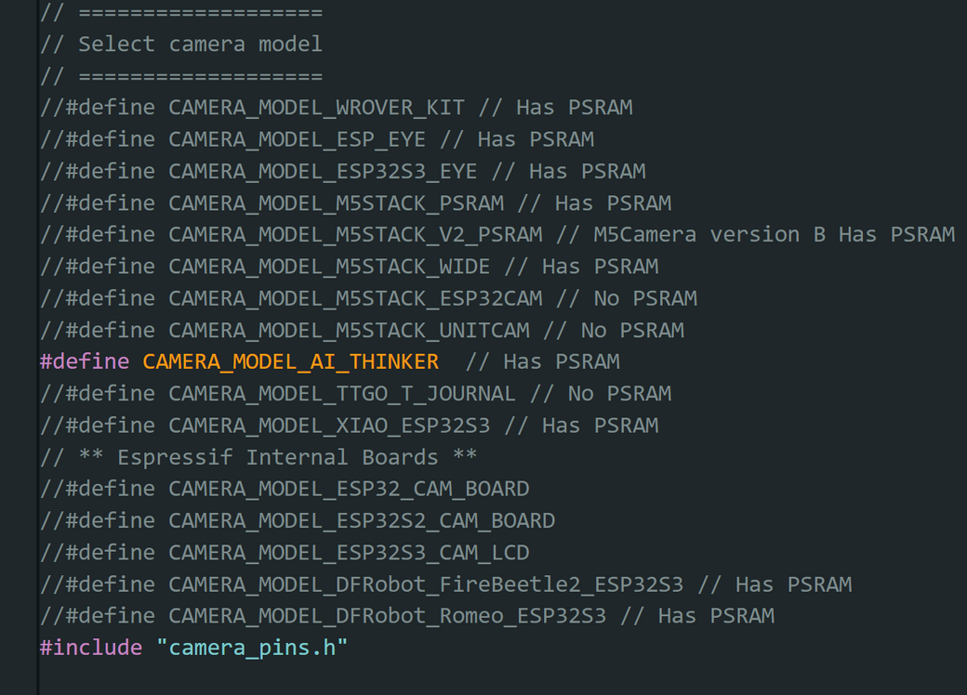
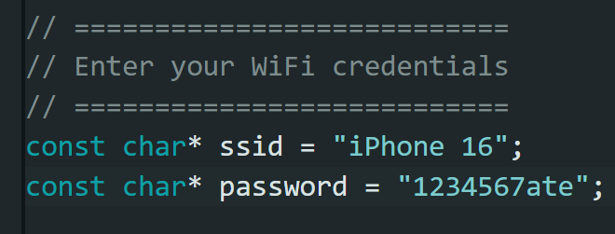
Get a picture from the camera with web requests

Slide 10
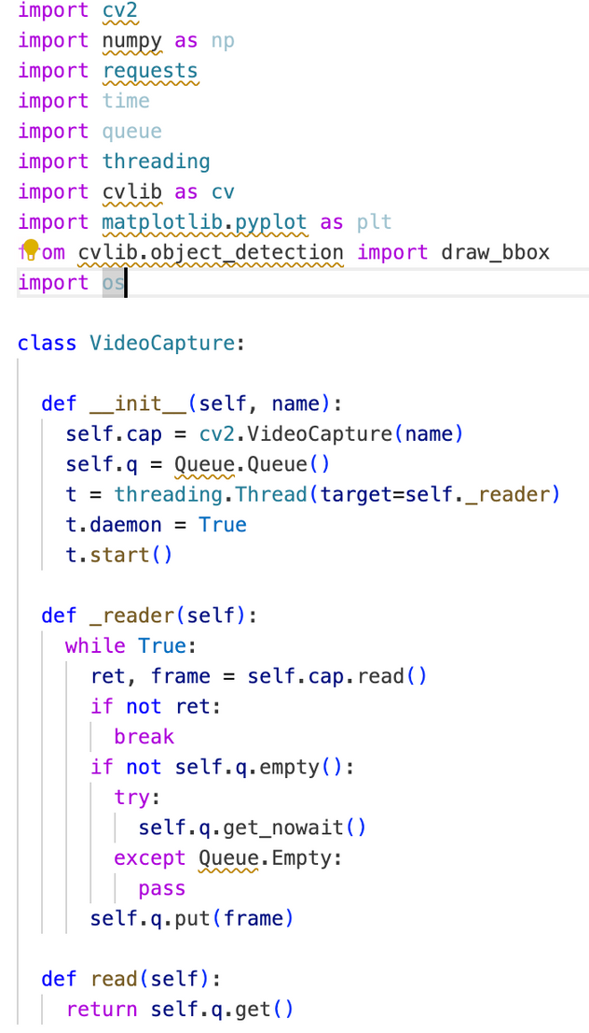
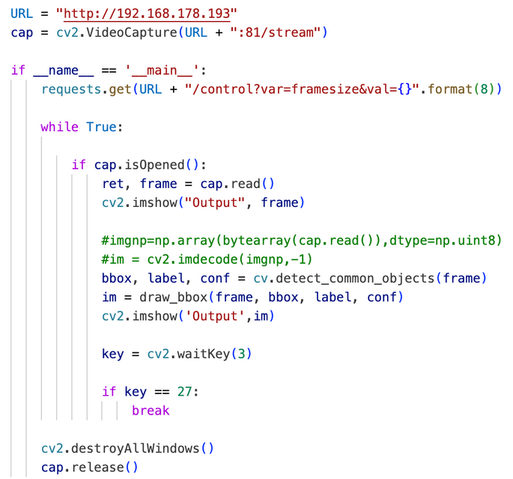
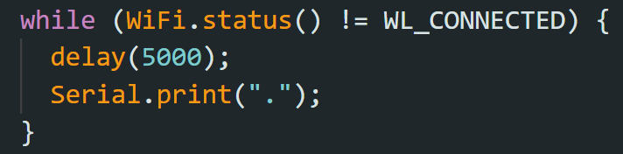
The Great Depression
WE DID IT WE GOT A PICTURE!! - Or so the students thought
They whipped up the python code in negative time
But the problems were never-ending:
Python code didn’t work...
Camera crashed local WiFi
WiFi didn’t connect at all
The dots of death...

Slide 11
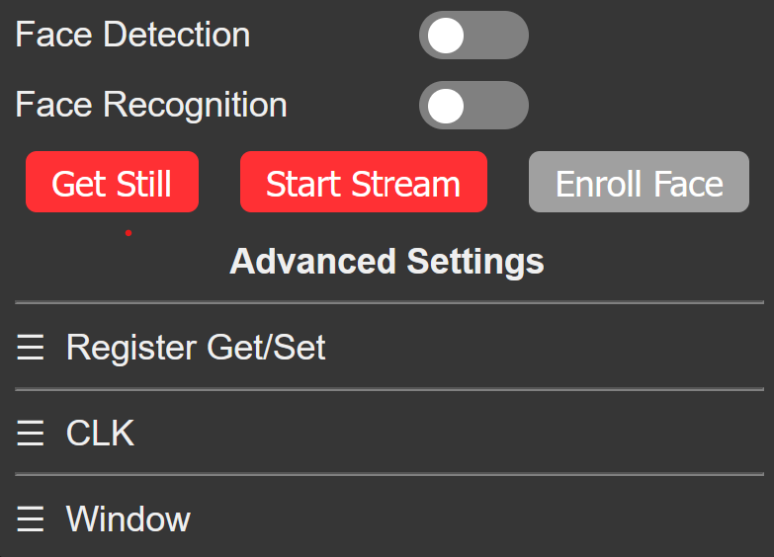
In a moment of despair

Slide 12
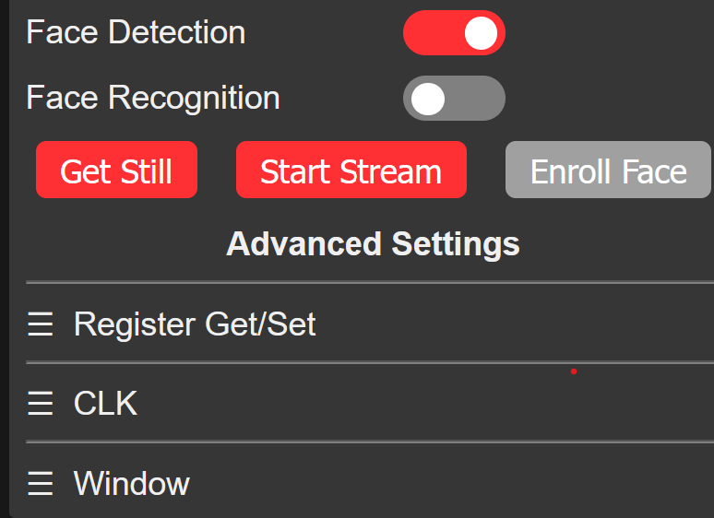
In a moment of despair

Slide 13


Slide 14
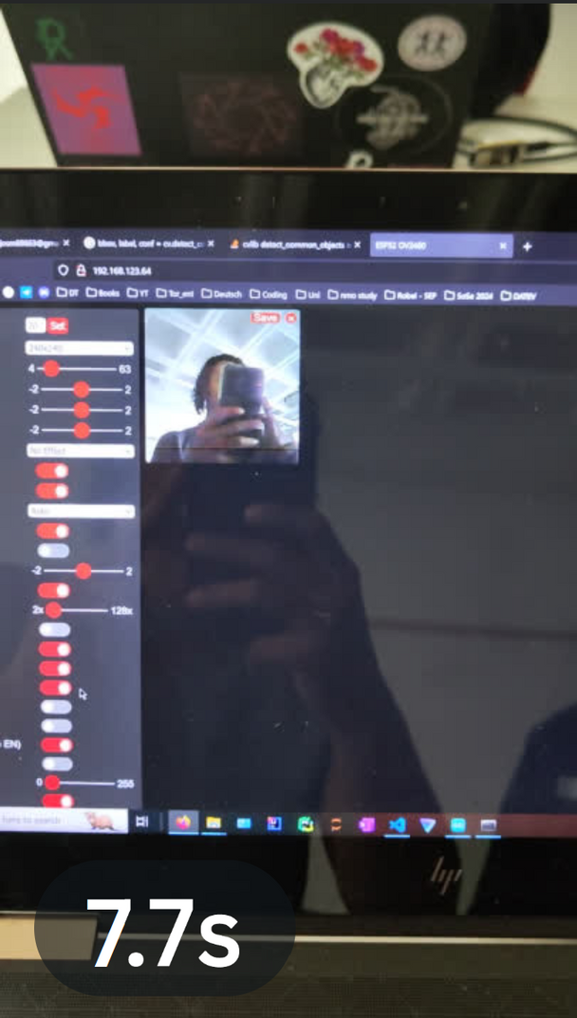

Slide 15
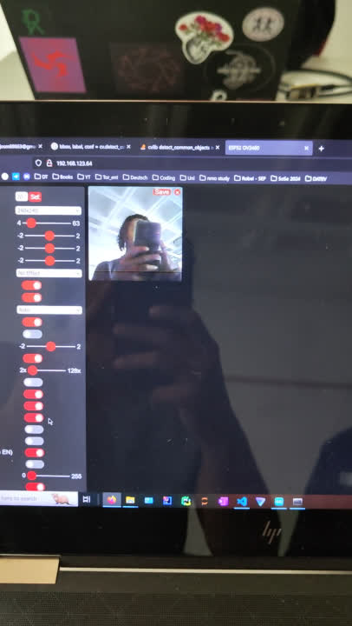

Slide 16
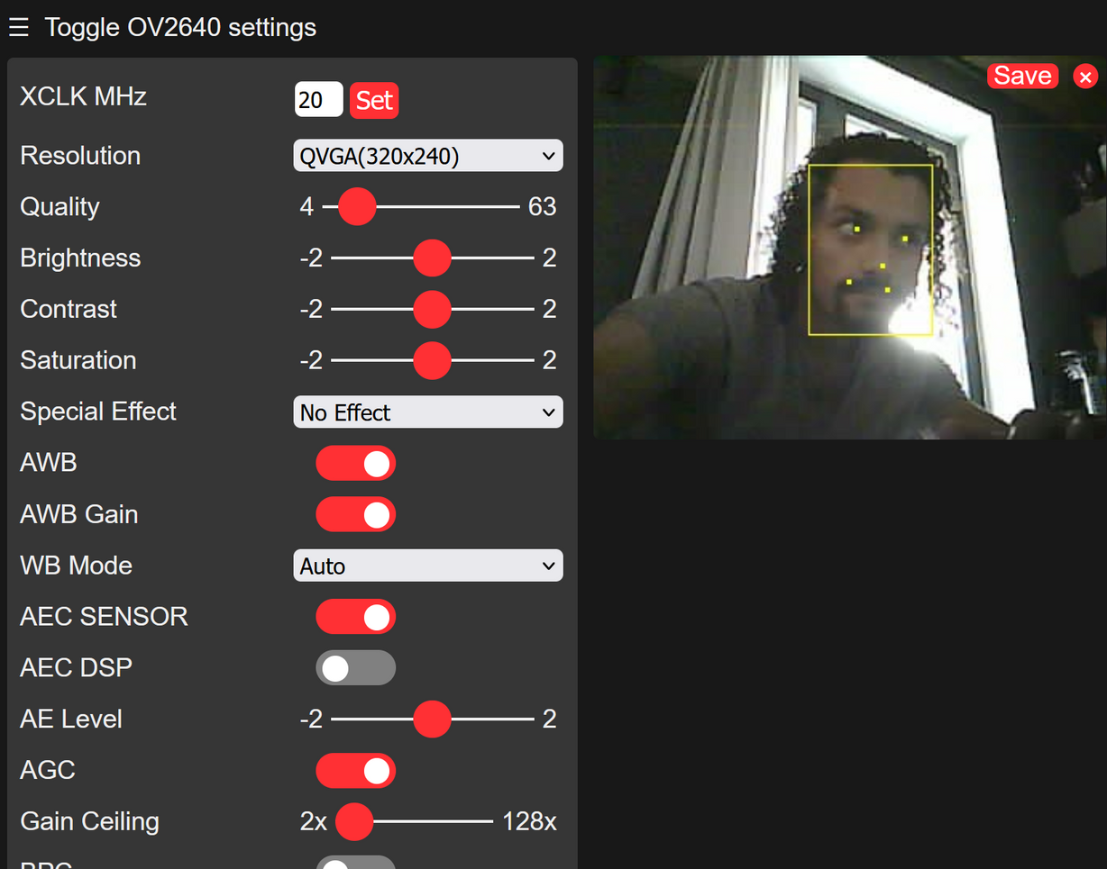

Slide 17
THANK YOU FOR YOUR
attention

